Slide 1
PROVERBS 14:34
“RIGHTEOUSNESS EXALTETH A NATION:
BUT SIN IS A REPROACH TO ANY PEOPLE.”

Slide 2
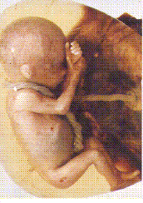
ABORTION

Slide 3
EVOLUTION

Slide 4
EVOLUTION

Slide 5
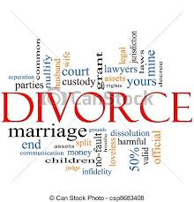
DIVORCE/REMARRIAGE LIVING TOGETHER

Slide 6
HOMOSEXUALITY
And they said...
Pope Francis:
If a person is gay and seeks God and has good will, who am I to judge them?

Slide 7
HOMOSEXUALITY
And they said...
Barack Obama, 44th President of the United States of America:
I had hesitated on gay marriage … I was sensitive to the fact that for a lot of people the word 'marriage' was something that invokes very powerful traditions, religious beliefs and so forth … When we think about our faith, the thing at root ... is not only Christ sacrificing himself on our behalf, but also the Golden Rule. You know! Treat others the way you would want to be treated.

Slide 8
HOMOSEXUALITY
And they said...
Mitt Romney, Republican presidential candidate:
This is a very tender and sensitive topic … My view is that marriage itself is a relationship between a man and a woman, and that’s my own preference.

Slide 9
HOMOSEXUALITY
And they said...
Basil Hume, Cardinal Archbishop of Westminster, 1923-1999, declaring that 'homophobia should have no place among Christians':
To love one another, whether of the same sex or of a different sex, is to have entered the area of the richest human experience.

Slide 10
HOMOSEXUALITY
And they said...
Anne Atkins, journalist:
God created us, and it is very clear that sex is created to be between two people of the opposite sex for life exclusively. That is what Christian marriage is. There’s no getting away from it, so anything outside of that is outside the ideal … Jesus was the perfect example. He didn’t have sexual relationships, but he was perfectly fulfilled.

Slide 11
HOMOSEXUALITY
And they said...
Rt Revd Alan Wison, Bishop of Buckingham: It all comes down to how we see gay people and how we see God. We don't actually believe gay people are sick or stunted or criminal. We don't believe God is an angry old man out to get us. Let's stop behaving as though we did.

Slide 12
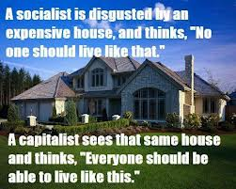
SOCIALISM/COMMUNISM IN PLACE OF CAPITALISM

Slide 13
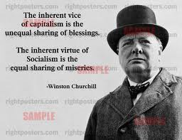
SOCIALISM/COMMUNISM IN PLACE OF CAPITALISM

Slide 14
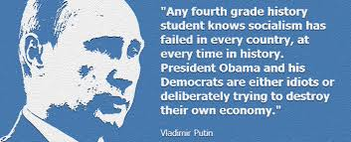
SOCIALISM/COMMUNISM IN PLACE OF CAPITALISM

Slide 15
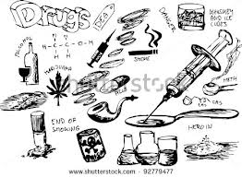
DRUGS AND ALCOHOL

Slide 16
DRUGS AND ALCOHOL

Slide 17
DRUGS AND ALCOHOL

Slide 18
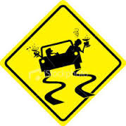
DRUGS AND ALCOHOL

Slide 19
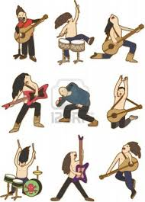
ROCK MUSIC

Slide 20
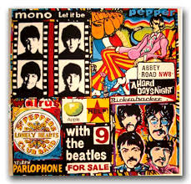
ROCK MUSIC

Slide 21
ROCK MUSIC

Slide 22
SLAVERY
RACISM
PORN
WOMEN
UNIONS
CLASS WARFARE
PROSTITU-TION

Slide 23
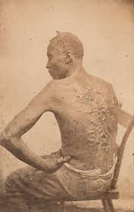
SLAVERY

Slide 24
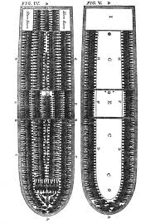
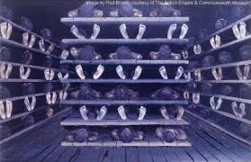
SLAVERY

Slide 25
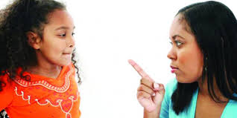
DISCIPLINE

Slide 26
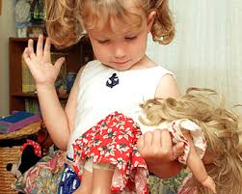
DISCIPLINE

Slide 27
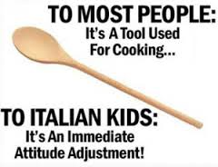
DISCIPLINE

Slide 28
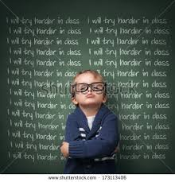
DISCIPLINE

Slide 29
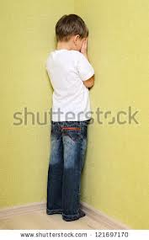
DISCIPLINE

Slide 30
SCHOOLS HAVE BECOME THE PARENTS
BREAKFAST
LUNCH
DINNER
DAYCARE
ABORTION
PLANNED PARENTHOOD
CONDOMS

Slide 31
ANTI-GOD ATTITUDE

Slide 32
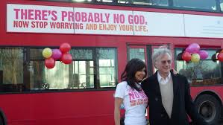
ANTI-GOD ATTITUDE

Slide 33
ANTI-GOD ATTITUDE

Slide 34
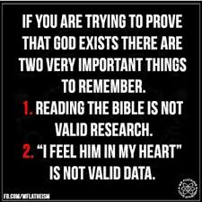
ANTI-GOD ATTITUDE

Slide 35
HEALTH SYSTEMS

Slide 36
HEALTH SYSTEMS

Slide 37
BIBLE
KJV

Slide 38
CHURCH

Slide 39
PRAYER

Slide 40
WITNESS

